Slide 1

Oracle Schema Objects
views, sequences, synonyms, indexes

Slide 2
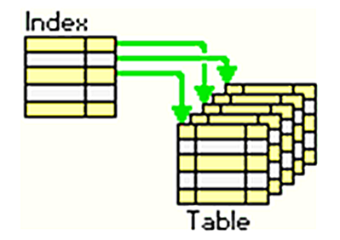
INDEXES
Indexes are optional structures associated with tables and clusters that allow SQL queries to execute more quickly against a table.
an Oracle Database index provides a faster access path to table data
Indexes are logically and physically independent of the data in the associated table. Being independent structures, they require storage space.
The database automatically maintains indexes when you insert, update, and delete rows of the associated table.

Slide 3
Indexing & Hashing
value
record
?
value

Slide 5
Science of Indexes
A single-level index is an auxiliary file that makes it more efficient to search for a record in the data file.
The index is usually specified on one field of the file (although it could be specified on several fields)
One form of an index is a file of entries <field value, pointer to record>, which is ordered by field value
The index is called an access path on the field.

Slide 6
Science of Indexes
The index file usually occupies considerably less disk blocks than the data file because its entries are much smaller
A binary search on the index yields a pointer to the file record
Indexes can also be characterized as dense or sparse
A dense index has an index entry for every search key value (and hence every record) in the data file.
A sparse (or nondense) index, on the other hand, has index entries for only some of the search values

Slide 7
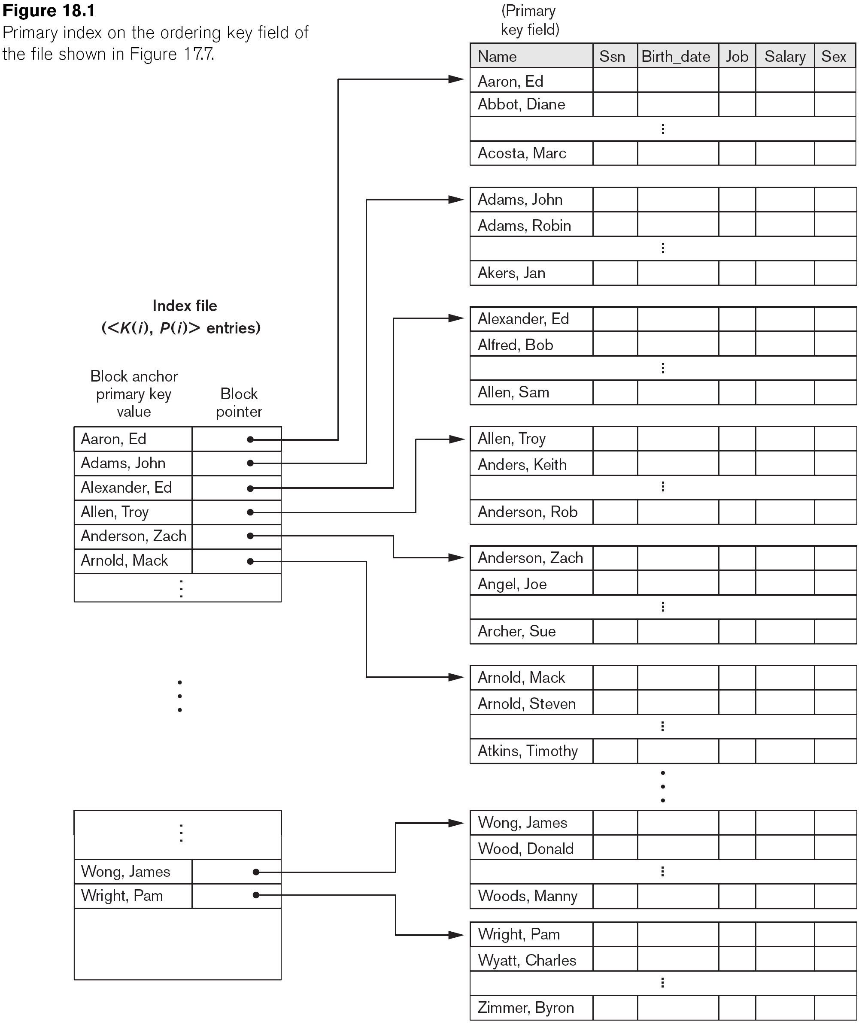
Science of Indexes
Types of Single-Level Indexes:
Primary Index
The data file is ordered on a key field
A primary index is a nondense (sparse) index

Slide 8
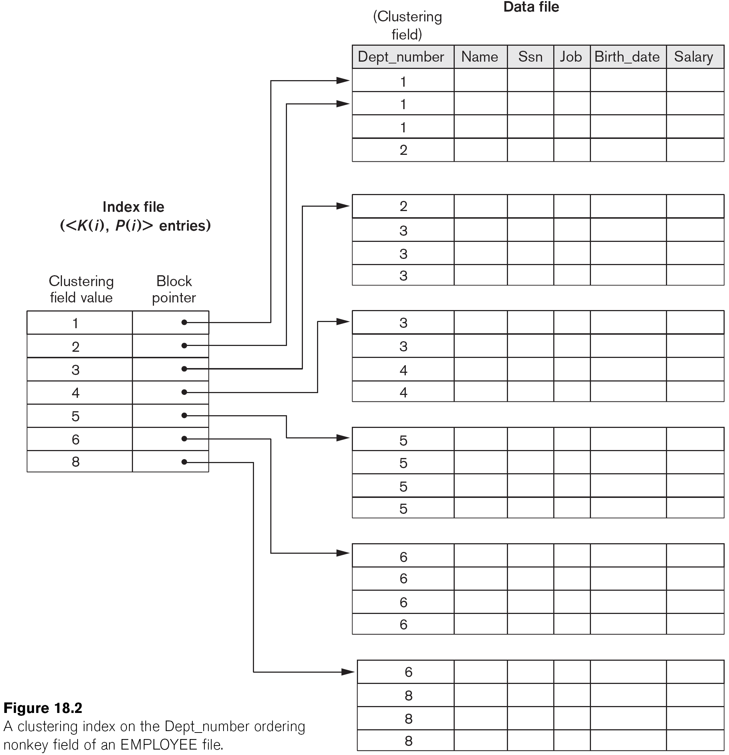
Science of Indexes
Types of Single-Level Indexes:
Clustering Index
Defined on an ordered data file
The data file is ordered on a non-key field
Includes one index entry for each distinct value of the field; the index entry points to the first data block that contains records with that field value.
nondense

Slide 9
Science of Indexes
Types of Single-Level Indexes:
Secondary Index
provides a secondary means of accessing a file for which some primary access already exists.
The secondary index may be on a field which is a candidate key and has a unique value in every record, or a non-key with duplicate values.
Includes one entry for each record in the data file; hence, it is a dense index

Slide 10
Multi-Level Indexes
Because a single-level index is an ordered file, we can create a primary index to the index itself;
In this case, the original index file is called the first-level index and the index to the index is called the second-level index

Slide 11
Dense Index
Sequential File
10
10
20
20
30
30
40
40
50
60
50
70
60
80
70
90
80
100
90
110
100
120

Slide 12
Sparse Index
Sequential File
10
10
30
20
50
30
70
40
90
110
50
130
60
150
70
170
80
190
90
210
100
230

Slide 13
Sparse 2nd level
Sequential File
10
10
10
90
30
20
170
50
30
250
70
40
90
330
50
110
410
60
130
490
150
570
70
170
80
190
90
210
100
230

Slide 14
Sparse vs. Dense Tradeoff
Sparse: Less index space per record can keep more of index in memory
Dense: Can tell if any record exists without accessing file

Slide 15
Duplicate keys
10
10
10
20
20
30
30
30
40
45

Slide 16
Dense index, one way to implement?
Duplicate keys
10
10
10
10
10
10
10
10
10
10
10
10
20
20
20
20
20
20
20
20
30
30
30
30
30
30
30
30
30
30
30
30
40
40
45
45

Slide 17
Duplicate keys
Dense index, better way?
10
10
10
20
30
10
40
20
20
30
30
30
40
45

Slide 18
Duplicate keys
Sparse index, one way?
10
10
10
10
20
10
30
20
20
30
30
30
40
45

Slide 19
Duplicate keys
Sparse index, one way?
10
10
10
10
20
10
careful if looking
for 20 or 30!
20
30
20
30
30
30
40
45

Slide 20
Duplicate keys
Sparse index, another way?
place first new key from block
10
10
10
20
30
10
30
20
20
30
30
30
40
45

Slide 21
Duplicate keys
Sparse index, another way?
place first new key from block
10
should
this be
40?
10
10
20
30
10
30
20
20
30
30
30
40
45

Slide 22
Duplicate values, primary index
Summary
Index may point to first instance of each value only
File
Index
a
a
a
.
.
b

Slide 23
Deletion from sparse index
10
10
20
30
50
30
70
40
50
90
60
110
130
70
150
80

Slide 24
Deletion from sparse index
delete record 40
10
10
20
30
50
30
70
40
50
90
60
110
130
70
150
80

Slide 25
Deletion from sparse index
delete record 40
10
10
20
30
50
30
70
40
50
90
60
110
130
70
150
80

Slide 26
Deletion from sparse index
delete record 30
10
10
20
30
50
30
70
40
50
90
60
110
130
70
150
80

Slide 27
Deletion from sparse index
delete record 30
10
10
20
40
30
50
30
40
70
40
50
90
60
110
130
70
150
80

Slide 28
Deletion from sparse index
delete records 30 & 40
10
10
20
30
50
30
70
40
50
90
60
110
130
70
150
80

Slide 29
Deletion from sparse index
delete records 30 & 40
10
10
20
30
50
30
70
40
50
90
60
110
130
70
150
80

Slide 30
Deletion from sparse index
delete records 30 & 40
10
10
20
50
30
70
50
30
70
40
50
90
60
110
130
70
150
80

Slide 31
Deletion from dense index
10
10
20
20
30
30
40
40
50
50
60
60
70
70
80
80

Slide 32
Deletion from dense index
delete record 30
10
10
20
20
30
30
40
40
50
50
60
60
70
70
80
80

Slide 33
Deletion from dense index
delete record 30
10
10
20
20
30
30
40
40
40
50
50
60
60
70
70
80
80

Slide 34
Deletion from dense index
delete record 30
10
10
20
20
40
30
30
40
40
40
50
50
60
60
70
70
80
80

Slide 35
Insertion, sparse index case
10
10
20
30
40
30
60
40
50
60

Slide 36
Insertion, sparse index case
insert record 34
10
10
20
30
40
30
60
40
50
60

Slide 37
Insertion, sparse index case
insert record 34
10
10
20
30
40
30
60
34
40
50
our lucky day!
we have free space
where we need it!
60

Slide 38
Insertion, sparse index case
insert record 15
10
10
20
30
40
30
60
40
50
60

Slide 39
Insertion, sparse index case
insert record 15
10
10
20
15
20
30
40
30
20
60
30
40
50
60

Slide 40
Insertion, sparse index case
insert record 15
10
10
20
15
20
30
40
30
20
60
30
40
50
Illustrated: Immediate reorganization
Variation:
insert new block (chained file)
update index
60

Slide 41
Insertion, sparse index case
insert record 25
10
10
20
30
40
30
60
40
50
60

Slide 42
Insertion, sparse index case
insert record 25
10
25
10
20
30
40
30
overflow blocks
(reorganize later...)
60
40
50
60

Slide 43
Previous Examples shows sequential structure
Lets look at Trees
Tree indices are pretty efficient

Slide 44
B-Tree
In B-Tree and B+-Tree data structures, each node corresponds to a disk block
In a B-tree, pointers to data records exist at all levels of the tree
In a B+-tree, all pointers to data records exists at the leaf-level nodes

Slide 45
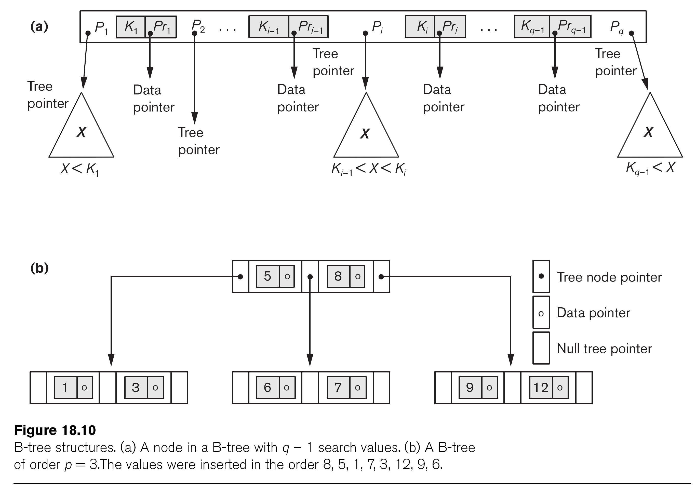
B-tree Structures

Slide 46
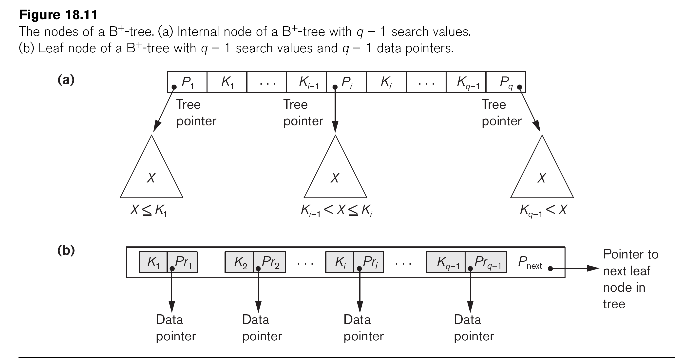
The Nodes of a B+-tree

Slide 47
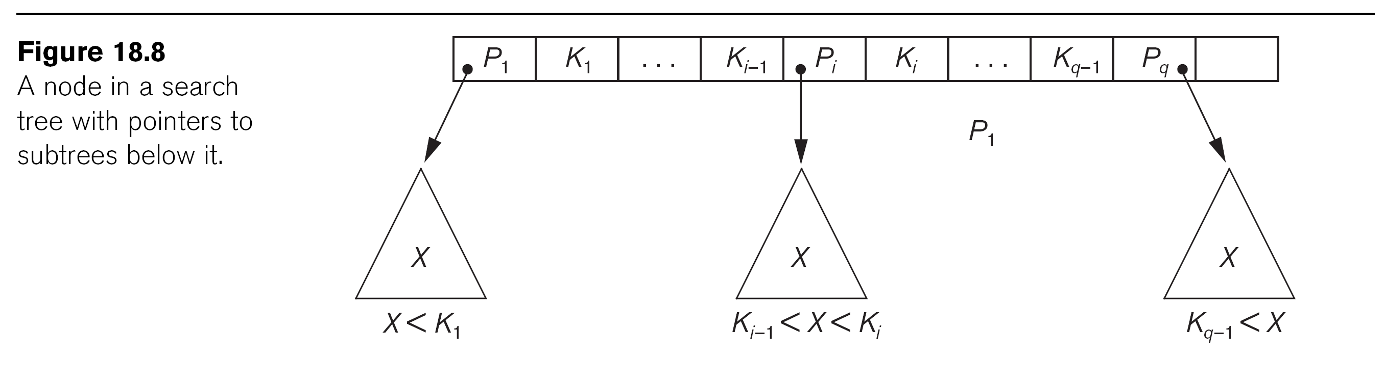
A Node in a Search Tree with Pointers to Subtrees Below It

Slide 48
B+Tree Example n=3
Root
100
30
120
150
180
3
5
11
30
35
100
101
110
120
130
150
156
179
180
200

Slide 49
Sample non-leaf
57
81
95
to keys to keys to keys to keys
< 57 57≤ k<81 81≤k<95 ≥95

Slide 50
Sample leaf node:
From non-leaf node
to next leaf
in sequence
57
81
95
To record
with key 57
To record
with key 81
To record
with key 85

Slide 51
Search Example n=3
Root
k= 120
100
30
120
150
180
3
5
11
30
35
100
101
110
120
130
150
156
179
180
200

Slide 52
Insert into B+tree
(a) simple case
space available in leaf
(b) leaf overflow
(c) non-leaf overflow
(d) new root

Slide 53
(a) Insert key = 32 space available in leaf
n=3
100
30
3
5
11
30
31

Slide 54
(a) Insert key = 32
n=3
100
30
3
5
11
30
31
32

Slide 55
(a) Insert key = 7 leaf overflow
n=3
100
30
3
5
11
30
31

Slide 56
(a) Insert key = 7
n=3
100
30
3
5
3
5
11
30
31
7

Slide 57
(a) Insert key = 7
n=3
100
30
7
3
5
3
5
11
30
31
7

Slide 58
(c) Insert key = 160 non-leaf overflow
n=3
100
120
150
180
150
156
179
180
200

Slide 59
(c) Insert key = 160
n=3
100
120
150
180
150
156
179
160
179
180
200

Slide 60
(c) Insert key = 160
n=3
100
120
150
180
180
150
156
179
160
179
180
200

Slide 61
(c) Insert key = 160
n=3
100
160
120
150
180
180
150
156
179
160
179
180
200

Slide 62
(d) New root, insert 45
n=3
10
20
30
1
2
3
10
12
20
25
30
32
40

Slide 63
(d) New root, insert 45
n=3
10
20
30
1
2
3
10
12
20
25
30
32
40
40
45

Slide 64
(d) New root, insert 45
n=3
10
20
30
40
1
2
3
10
12
20
25
30
32
40
40
45

Slide 65
(d) New root, insert 45
n=3
30
new root
10
20
30
40
1
2
3
10
12
20
25
30
32
40
40
45

Slide 66
Deletion from B+tree
(a) Simple case - no example
(b) Coalesce with neighbor (sibling)
(c) Re-distribute keys
(d) Cases (b) or (c) at non-leaf

Slide 67
(b) Coalesce with sibling
Delete 50
n=4
10
40
100
10
20
30
40
50

Slide 68
(b) Coalesce with sibling
Delete 50
n=4
10
40
100
10
20
30
40
50
40

Slide 69
(c) Redistribute keys
Delete 50
n=4
10
40
100
10
20
30
35
40
50

Slide 70
(c) Redistribute keys
Delete 50
n=4
10
40
100
35
10
20
30
35
40
50
35

Slide 71
(d) Non-leaf coalese
Delete 37
n=4
25
10
20
30
40
25
26
1
3
10
14
20
22
30
37
40
45

Slide 72
(d) Non-leaf coalese
Delete 37
n=4
25
10
20
30
40
25
26
1
3
10
14
20
22
30
37
40
45
30

Slide 73
(d) Non-leaf coalese
Delete 37
n=4
25
10
20
30
40
40
25
26
1
3
10
14
20
22
30
37
40
45
30

Slide 74
(d) Non-leaf coalese
Delete 37
n=4
25
new root
10
20
30
40
25
40
25
26
1
3
10
14
20
22
30
37
40
45
30

Slide 75
Back to oracle

Slide 76
When to Use Them
To improve performance on joins of multiple tables, index columns used for joins.
Primary and unique keys automatically have indexes, but you might want to create an index on a foreign key.
Candidate columns for indexing
Values are relatively unique in the column.
Columns used frequently in the where clause
Columns with many NULLs and often queries check for NOT NULL
WHERE col_x IS NOT NULL
Columns that are not suitable for Indexing
May NULLs in the columns and filtering for not null in the queries
LONG and LONG RAW columns cannot be indexed.

Slide 77
Index types & Privileges
Indexes can be unique or non-unique.
Unique indexes guarantee that no two rows of a table have duplicate values in the key column (or columns).
Non-unique indexes do not impose this restriction on the column values.
Required Privileges
The table or cluster to be indexed is in your own schema.
You have INDEX privilege on the table to be indexed.
You have CREATE ANY INDEX system privilege.
CREATE INDEX orders_ind1 ON orders (order_date);
CREATE UNIQUE INDEX orders_ind2 ON oe.orders (order_num);

Slide 78
How Indexes Work
Oracle retrieves rows from a table in only one of two ways:
By ROWID
By full-table scan
Oracle uses B-Tree (or bitmap) to map column data to ROWIDs
Indexes may improve the performance of SELECT, UPDATE, and DELETE operations. You can use an index if a subset of the indexed columns appear in the SELECT or WHERE clause
if all the columns needed to satisfy a query appear in an index, Oracle can access only the index and not the table
Example next slide

Slide 79
example: if all the columns needed to satisfy a query appear in an index, Oracle can access only the index and not the table
Assume in the HR table we have an index on LAST_NAME and FIRST_NAME
Oracle needs to access only the index, not the table to solve this query
SELECT COUNT(*) FROM hr.employees WHERE last_name = ‘Smith';

Slide 80
Using B-Tree Indexes
B-tree indexes are the most common index type, as well as the default.
The B-tree indexes include index column values and the ROWID of the row.
The ROWID uniquely identifies a row in the table.
B-tree indexes provide the best performance on high-cardinality columns, which are columns that have many distinct values
For example, in the HR.EMPLOYEES table, the columns LAST_NAME and PHONE_NUMBER are high-cardinality columns. JOB_ID is a low-cardinality column.

Slide 81
Creating Indexes
The CREATE INDEX statement creates a nonunique B-tree index on the columns specified
Nonunique Index
Unique Index
Composite Index
CREATE INDEX orders_ind1 ON orders (order_date);
CREATE UNIQUE INDEX orders_ind2 ON oe.orders (order_num);
CREATE INDEX oe.order_ind4 ON oe.orders (customer_id, sales_rep_id);

Slide 82
Quiz Q1
Q: In a join view, on how many base tables can you perform a DML operation (UPDATE/INSERT/DELETE) in a single step?
One
The number of base tables in the view definition
The number of base tables minus one
None

Slide 83
Quiz Q2
The following code is used to define a view. The EMP table does not have a primary key or any other constraints.
SELECT, INSERT, UPDATE, DELETE
SELECT, UPDATE
SELECT, INSERT, DELETE
SELECT
SELECT, UPDATE, DELETE
CREATE VIEW MYVIEW AS SELECT DISTINCT ENAME, SALARY FROM EMP WHERE DEPT_ID = 10;

Slide 84
Quiz Q3
Which statements are used to modify a view definition?
ALTER VIEW
CREATE OR REPLACE VIEW
REPLACE VIEW
CREATE FORCE VIEW
CREATE OR REPLACE FORCE VIEW

Slide 85
Quiz Q4
You create a view based on the EMPLOYEES table using the following SQL
Nothing. Since the view definition is selecting all columns, the new column will appear in the view automatically.
Recompile the view using ALTER VIEW MYVIEW RECOMPILE.
Re-create the view using CREATE OR REPLACE VIEW.
Add the column to the view using ALTER VIEW MYVIEW ADD EMP_SSN.
CREATE VIEW MYVIEW AS
SELECT *
FROM EMPLOYEES;

Slide 86
Quiz Q6
The EMPLOYEE table has the following columns:
A view is defined using the following SQL:
Which INSERT statement will succeed through the view?
EMP_ID NUMBER (4) PRIMARY KEY EMP_NAME VARCHAR2 (30) SALARY NUMBER (6,2) DEPT_ID VARCHAR2 (2)
INSERT INTO EMP_IN_DEPT10 VALUES (1000, 'JOHN',1500,'HR');
INSERT INTO EMP_IN_DEPT10 VALUES (1001, NULL,1700,'AM');
INSERT INTO EMP_IN_DEPT10 VALUES (1002, 'BILL',2500,'AC');
All mentioned statements are correct
CREATE VIEW EMP_IN_DEPT10 AS SELECT * FROM EMPLOYEE WHERE DEPT_ID = 'HR';

Slide 87
Quiz Q7
There is a public synonym named PLAN_TABLE for SYSTEM.PLAN_TABLE. Which of the following statements will remove this public synonym from the database?
drop table system.plan_table;
drop synonym plan_table;
drop table system.plan_table cascade;
drop public synonym plan_table;

Slide 88
Quiz Q8
A developer reports that she is receiving the following error:
create sequence key_seq;
create synonym key_seq;
select key_seq.nextval from dual;
grant create sequence to public;
SELECT key_seq.currval FROM dual; ERROR at line 1: ORA-08002: sequence KEY_SEQ.CURRVAL is not yet defined

Slide 89
Quiz Q10
Which clauses in a SELECT statement can an index be used for?
SELECT
FROM
WHERE
HAVING

Slide 90
Quiz Q11
Which statement will create a sequence that will rotate through 100 values in a round-robin manner?
create sequence roundrobin cycle maxvalue 100;
create sequence roundrobin cycle to 100;
create sequence max_value 100 roundrobin cycle;
create rotating sequence roundrobin min 1 max 100;

Slide 91
Quiz Q9
Which statement will display the last number generated from the EMP_SEQ sequence?
select emp_seq.curr_val from dual;
select emp_seq.currval from dual;
select emp_seq.lastval from dual;
select last_number from all_sequences where sequence_name ='EMP_SEQ';
You cannot get the last sequence number generated.

Slide 92
Quiz insights
When you modify the base table, the view becomes invalid
The OR REPLACE option in the CREATE VIEW statement is used to modify the definition of the view.
The FORCE option can be used to create the view with errors.
The ALTER VIEW statement is used to compile a view or to add or modify constraints on the view.
Since the view definition includes a DISTINCT clause, only queries are allowed on the view.
You can perform an INSERT, UPDATE, or DELETE operation on the columns involving only one base table at a time
Watch for WITH CHECK OPTION clause
To be able to update a base table using the view, the view definition should not have a DISTINCT clause, a GROUP BY clause, a START WITH clause, a CONNECT BY clause, ROWNUM, set operators (UNION, UNION ALL, INTERSECT, or MINUS), or a subquery in the SELECT clause.
For a descending sequence, the default START WITH value is -1, and the default MAXVALUE value is -1. To start the sequence with 0, you must explicitly override both of these defaults.
When the underlying object is dropped, the synonym will become INVALID. You can see the status of the synonym by querying the USER_OBJECTS dictionary view.
To remove a public synonym, use the DROP PUBLIC SYNONYM statement. The DROP TABLE statement will remove a table from the database but will not drop any synonyms on the table. The synonym will become invalid.
A sequence is not yet initialized if NEXTVAL has not yet been selected from it within the current session. It has nothing to do with creating a sequence, creating a synonym, or granting privileges.

